Slide 1

Villa Fisherman’s at lake district
Alazani Valley Resort
Vine Estate
2025

Slide 2
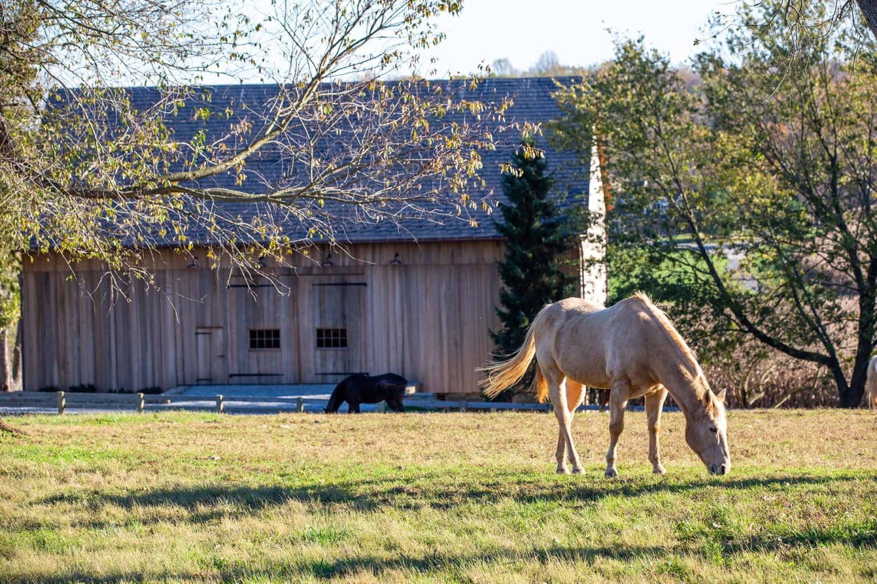
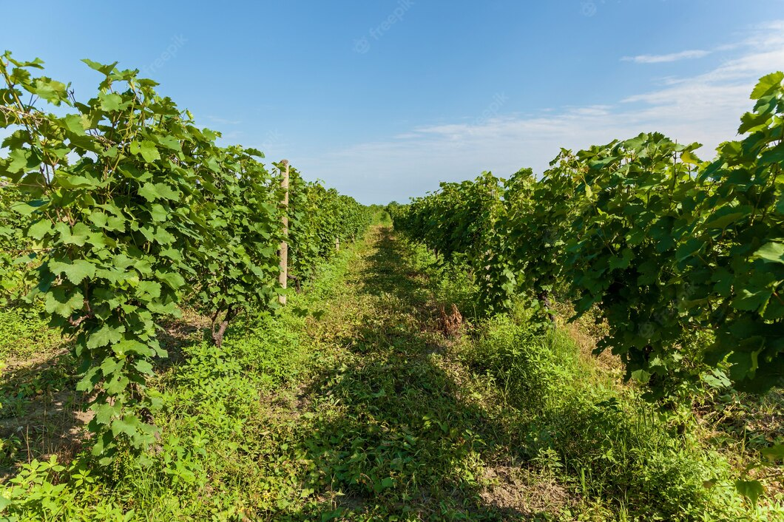
Villa Fisherman’s at lake district ecosystem
Georgian bio Vineyards
Wine cellar and special bio wines
Georgian ethnic restaurant
Paddle courts
Creation of own labeled exclusive wine and shipment service
Membership in closed wine club
Georgian private exclusive dining (dishes prepared through eco products from the garden)
Private cook
Horse Stable
Open swimming pool
Open gym
Volleyball court
Children's playground
Children's pool
Concierge service
Technical service 24/7
Security 24/7
Parking
Heliport

Slide 3
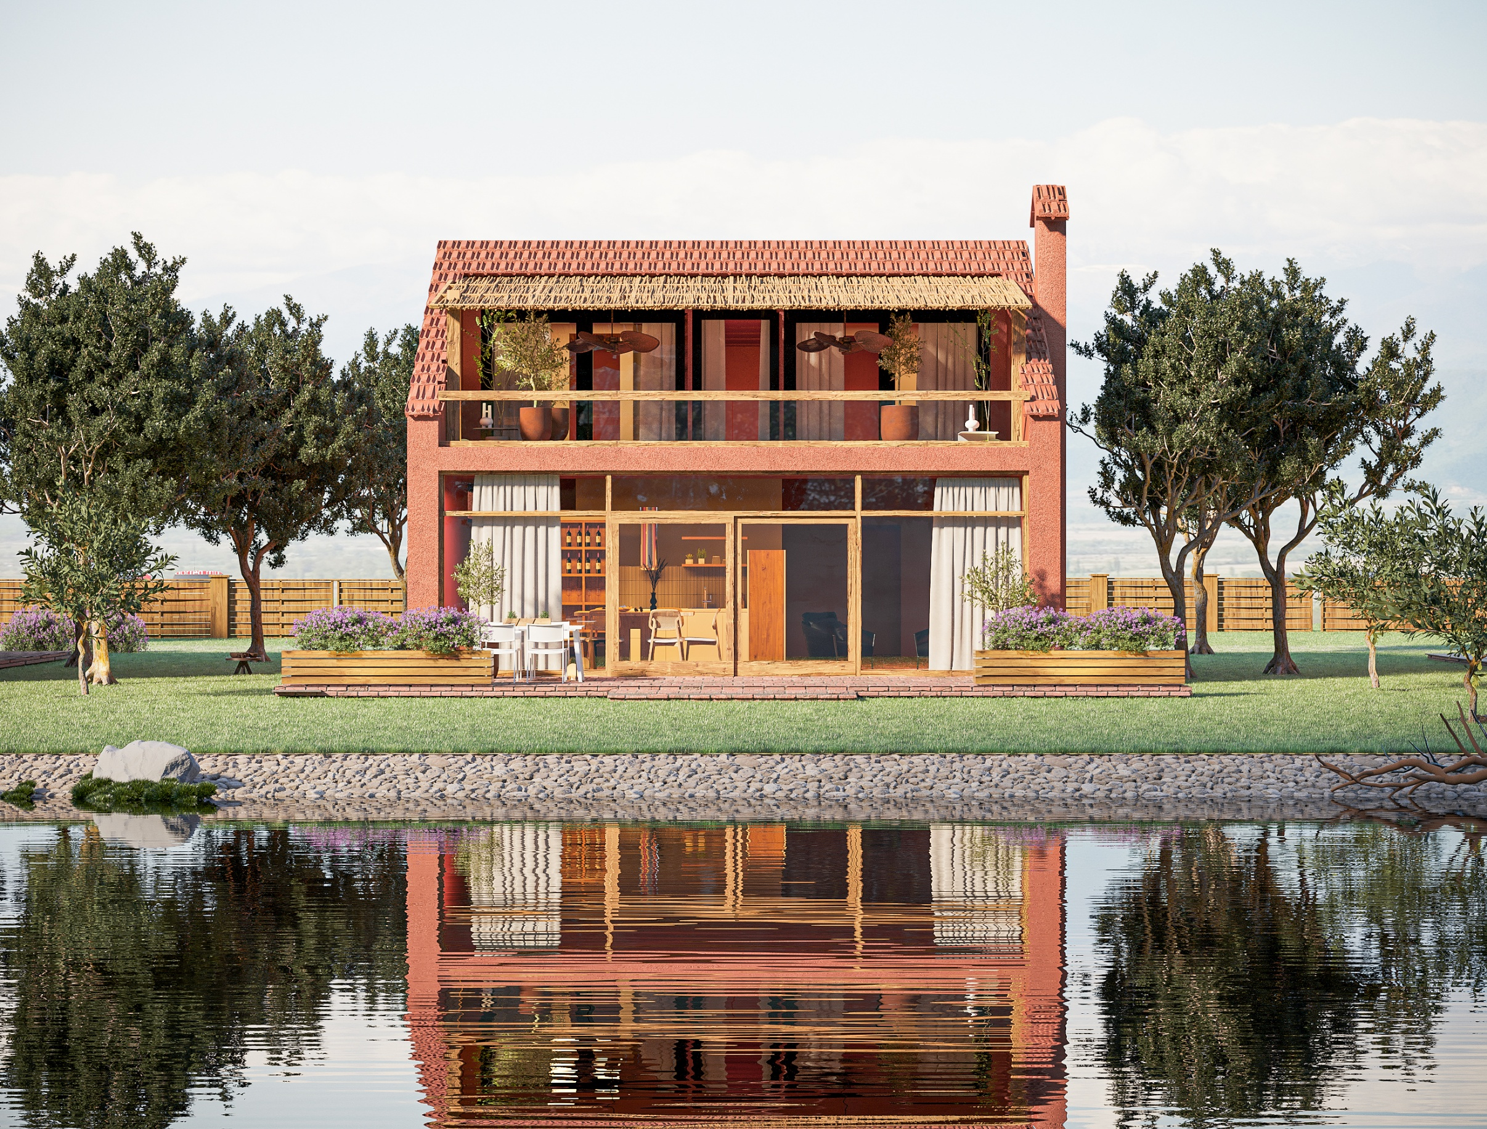
Villa Fisherman's
Land: 350 m2
3 bedroom Property: 195 m2
1 Floor: 110 m2
Terrace incl: 25 m2
2 Floor: 85 m2
Terrace incl: 27 m2

Slide 4
Villa Fisherman’s at lake district, Alazani Valley Resort
Vine Estate
A smart & sustainable investment that brings pleasure to you and your family!
Sustainable Real Estate in Telavi District of beautiful Kisiskhevi province, 3 km away from Tsinandali and Telavi
New trend of Agritourism
Quality of life
Quality Real Estate

Slide 5
Special offer for pre-sales:
Start of the project: September, 2025
Duration: 18 - 21 months
Special Early Sale Price until September 30, 2025:
M2 from $1600
Status: Renovated, Kitchen, and bathroom
ROI: 8-10%
Down payment: after signing the pre-purchase agreement 30%
Internal postponement until the completion of the project: 70%
Management and maintenance in collaboration of an international hotel brand
Video monitoring during construction, monthly reports and photos of the construction progress.
After delivery, a transparent accounting system for homeowners and monthly financial reports.

Slide 6
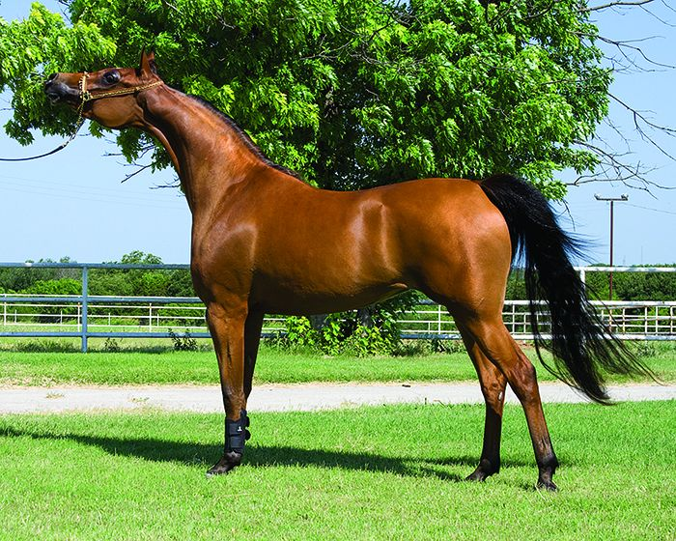

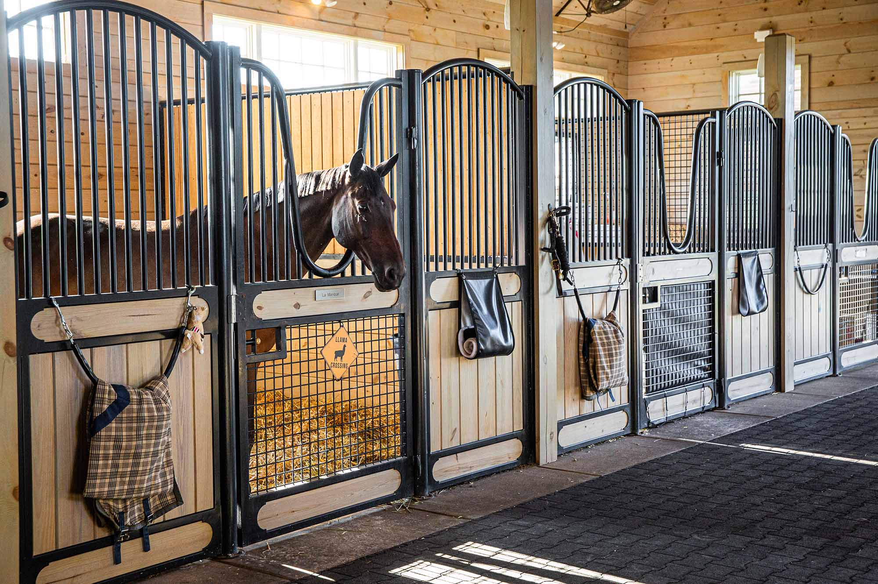
A dream Horse
& horse nursery
Horse Stable
& Rental

